Slide 1

ISEE Project – Team DroidKnights
Milestone #1 - Team Presentation

Slide 2
Contents
ISEE Project - Team DroidKnights
Milestone #1 - Team Presentation
01
02
The team
The project
Skills, background and personal motivation of team members.
Project topic selected and the motivation behind it.
03
04
Initial approach
Project progress
Primary division of workload and basic plan
Tasks completed and the future work.

Slide 3
01
The team
ISEE Project - Team DroidKnights
Milestone #1 - Team Presentation
Skills, background and personal motivation of team members

Slide 4
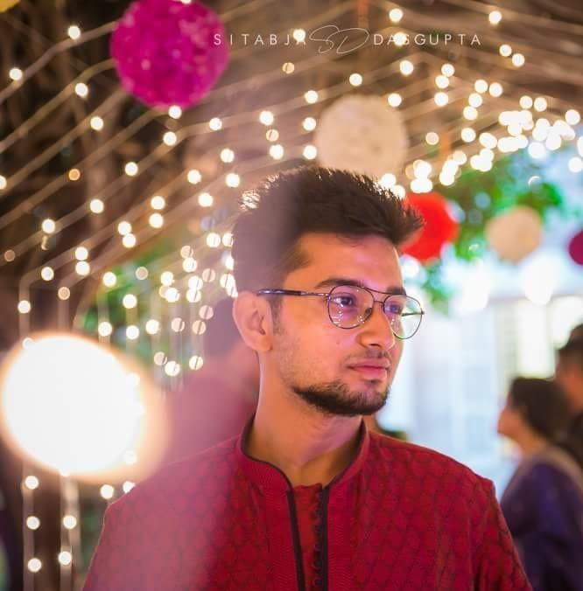
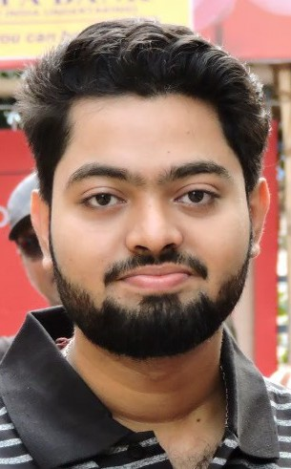
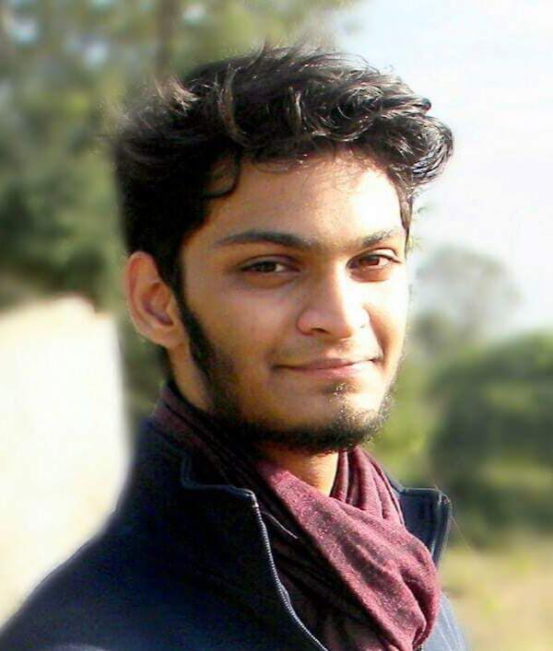
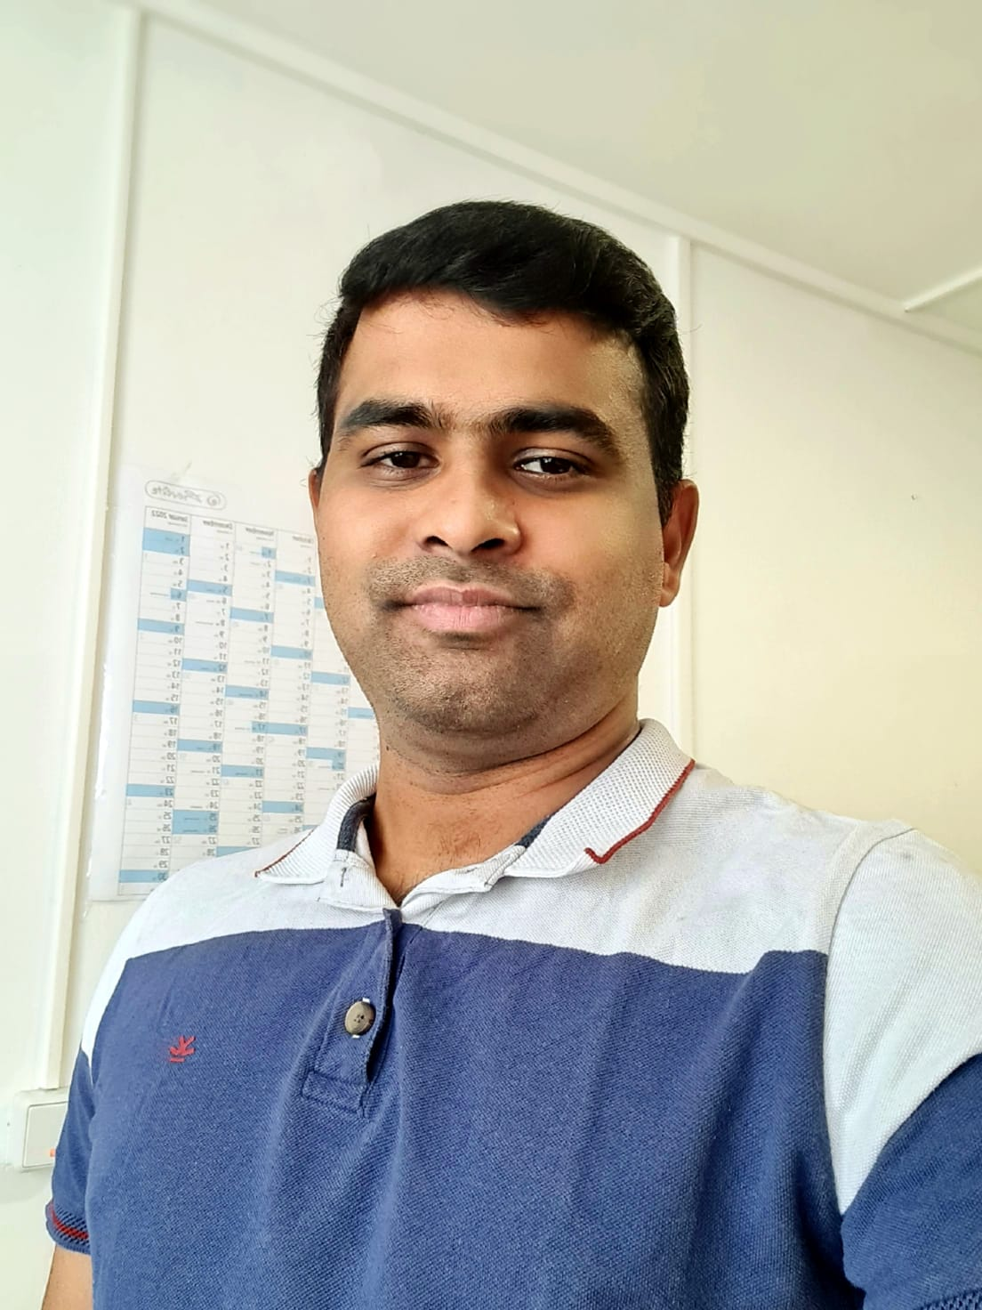
ISEE Project - Team DroidKnights
Milestone #1 - Team Presentation
Personal Motivation
Managing a team to an ultimate goal
Keeping up with a new field of Android Development.
Get hands-on experience on an integral part of Industry 4.0
Enhance management and technical skills.
Abhirup Roy
M. Sc. Digital Engineering
Anjan Chatterjee
M. Sc. Digital Engineering
Build Team coordination.
Enhance Programming skills
Be a part of the team and contribute to the success of the project
Acquire new skills by working on a real world application.
Denzil Correa
M. Sc. Operations Research and Business Analytics
Harshavardhan Reddy
M. Sc. Digital Engineering

Slide 5
Vision
TEAM VISION
ISEE Project - Team DroidKnights
Milestone #1 - Team Presentation
“We are a group of budding coders with not much experience in Android development but willing to learn and develop a functional app to address our very own issue of sticking to budget, and overall operate inside an interdisciplinary team playing on each other’s strength.”

Slide 6
ISEE Project - Team DroidKnights
Milestone #1 - Team Presentation
Skills and Background
Python
C
MatLab
ArduinoNode MCU
C++
Java
Abhirup Roy
M. Sc. Digital Engineering
Anjan Chatterjee
M. Sc. Digital Engineering
AMPL
Git
R
Denzil Correa
M. Sc. Operations Research and Business Analytics
Harshavardhan Reddy
M. Sc. Digital Engineering

Slide 7
02
The project
ISEE Project - Team DroidKnights
Milestone #1 - Team Presentation
Project topic selected and the motivation behind it

Slide 8

Money control
ISEE Project - Team DroidKnights
Milestone #1 - Team Presentation
01
Digital world lures us to spend.
02
Keeping track of what is spent becomes tedious.
03
Balance between income and expenditure should be monitored.
04
Statistical history of money flow could help user detect bad spending and curb it.

Slide 9
03
Initial approach
ISEE Project - Team DroidKnights
Milestone #1 - Team Presentation
Primary division of workload and basic plan

Slide 10
Primary plan
01
04
02
05
03
ISEE Project - Team DroidKnights
Milestone #1 - Team Presentation
Zoom or whatsapp team internal meeting regularly each week.
Role reversal is important so that every member gets to work on everything.
Google Drive to add, edit, share project document/files collaboratively.
Agile way of working to meet customer requirements.
Denzil is primarily assigned to blog writing whereas Abhirup, Harsha and Anjan works on the basic prototype.

Slide 11
04
Project progress
ISEE Project - Team DroidKnights
Milestone #1 - Team Presentation
Tasks completed and the future work

Slide 12
Completed
To do
✓
✓
✓
✓
✓
✓
ISEE Project - Team DroidKnights
Milestone #1 - Team Presentation
Build a team.
Draft work packets and role assignments.
Define team’s name and logo.
Weekly monitoring of the progress for each member.
Select a project and start working on the prototype.
Documenting weekly meeting details.
Follow our blog here: https://code.ovgu.de/roy/isee_21_droidknights_moneycontrol/-/wikis/Team-Presentation

Slide 13
05
Thank you!
ISEE Project - Team DroidKnights
Milestone #1 - Team Presentation
Questions?

